Slide 1
Policy Iteration
And POMDPs
Dave Touretzky
Read R&N sections 17.3-17.4

Slide 2
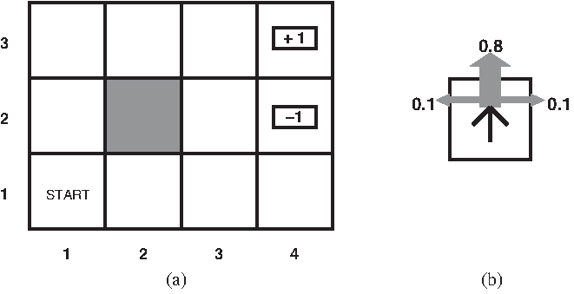
A grid world MDP
Assume reward R(s) = -0.04 for non-terminal states.
Actions = {Up, Down, Left, Right}

Slide 3
The Bellman equation
A state’s utility depends in part on the utilities of its successor states.
This is expressed by the Bellman equation, which defines U(s) in terms of U(s’):
U(s) = R(s) + 𝛾 max_{a} ∑_{s’} P(s’ | s,a) ∙ U(s’)
Example: for state (1,1) in our simple MDP:
U(1,1) = -0.04 + 𝛾 max [ 0.8 U(1,2) + 0.1 U(2,1) + 0.1 U(1,1), (Up) 0.9 U(1,1) + 0.1 U(1,2), (Left) 0.9 U(1,1) + 0.1 U(2,1), (Down) 0.8 U(2,1) + 0.1 U(1,2) + 0.1 U(1,1) ] (Right)

Slide 4
Value iteration
The Bellman equation describes a fixed point for U.
We can reach that state by an iterative computation called value iteration.
Let U_{i}(s) be the utility of state s on the ith iteration.
Bellman update:
U_{i+1}(s) ← R(s) + 𝛾 max_{a} ∑_{s’} P(s’ | s,a) ∙ U_{i}(s’)
Value iteration is guaranteed to converge to a unique solution U*. A policy π*(s) that uses U* to evaluate actions will be an optimal policy.

Slide 5
function VALUE-ITERATION(mdp, ε) returns a utility function U(s) inputs: mdp, an MDP with states S, actions A(s), transition model P(s’ | s,a), rewards R(s), discount factor 𝛾 ε, the maximum error allowed in the utility of any state local variables: U, U’ vectors of utilities for states in S, initially zero 𝛿, the maximum change in the utility of any state in an iteration repeat U ←U’; 𝛿 ←0 for each state s in S do U’[s] ←R(s) + 𝛾 max_{a} ∑_{s’} P(s’ | s,a) ∙ U[s] if |U’[s] - U[s]| > 𝛿 then 𝛿 ←|U’[s] - U[s]| until 𝛿 < ε(1-𝛾)/𝛾 return U

Slide 6
Convergence of value iteration
A contraction is a function f(x) such that the distance from f(a) to f(b) is strictly less than the distance from a to b.
Example: f(x) = x/2 is a contraction with a fixed point at 0.
A contraction has exactly one fixed point. Why?

Slide 7
Belman update as contraction
Regard the Belman update as an operator B: U_{i+1} ← B U_{i}
Define the max norm to measure the “length” of a utility vector as the absolute value of the largest component: ||U|| = max_{s} |U(s)|
Define the “distance” between any two utility vectors as ||U-U’||.
The Belman update is a contraction by a factor of 𝛾 (proof omitted): ||B U_{i} - B U_{i}’|| ≤ 𝛾||U_{i} - U_{i’}||

Slide 8
Rate of convergence
Let U be the true utility, for which B U = U.
||B U_{i} - U|| ≤ 𝛾||U_{i} - U||
||U_{i} - U|| is the error in the estimate U_{i}, and it decreases by a factor of 𝛾 with each update.
So value iteration converges exponentially fast.
Error bound: if updates are small and ||U_{i+1} - U_{i}|| < ε(1-𝛾)/𝛾, then ||U_{i+1} - U|| < ε. This is the termination condition used in value iteration.

Slide 9
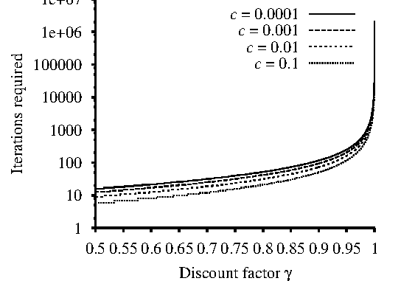
Less discounting means slower convergence
Max error is c ∙ R_{max}.

Slide 10
What’s the problem with value iteration?
On every iteration i, value iteration evaluates the utility of every action in every state, and for each state, picks the action with highest utility.
Thus, it effectively creates a new policy π_{i} on each iteration.
It does this using the max function, which is nonlinear. U(s) = R(s) + 𝛾 max_{a} ∑_{s’} P(s’ | s,a) ∙ U(s’)
The end result is the true utility U*, which gives us the optimal policy π*.
But are there more efficient ways to get there?
Nonlinearity

Slide 11
Policy iteration
What we really want to do is find the optimal policy π*, which can be done even if the utility function U(s) is only approximate.
So search the space of possible policies π. This space is finite.
With n states and b actions per state, there are b^{n} policies.
Policy iteration in a nutshell:
Start with an arbitrary policy π₀.
With each iteration i, evaluate the policy π_{i} to obtain U_{i}.
Formulate an improved policy π_{i+1} by selecting the best action for each state s according to U_{i}(s).

Slide 12
function POLICY-ITERATION(mdp) returns a policy π inputs: mdp, an MDP with states S, actions A(s), transition model P(s’ | s,a) local variables: U, a vector of utilities for states in S, initially zero π, a policy vector indexed by state, initially random repeat U ← POLICY-EVALUATION(π, U, mdp) unchanged? ← true for each state s in S do if max_{a} ∑_{s’} P(s’ | s,a) ∙ U(s’) > ∑_{s’} P(s’ | s,π[s]) ∙ U(s’) then do π[s] ← argmax_{a} ∑_{s’} P(s’ | s,a) ∙ U(s’) unchanged? ← false until unchanged? return π

Slide 13
The policy evaluation step
In order to improve on the current policy π we need to know U^{π} so we can evaluate all possible actions at every state.
But U^{π} is easy to compute. Why?
Since we’re following the policy: U(s) = R(s) + 𝛾 ∑_{s’} P(s’ | s,π[s]) ∙ U(s’)
With n states there are n of these Bellman equations, but they’re linear.
Can solve in one step as a series of linear equations.
But this takes O(n³) time. Could take a while if n is large.
No nonlinearity!

Slide 14
Cheaper policy evaluation
We don’t need an exact solution to U^{π}.
We just need something good enough to find an improvement on π.
Solution 1: approximate U^{π} by doing a few steps of simplified Bellman update: U(s) ← R(s) + 𝛾 ∑_{s’} P(s’ | s,π[s]) ∙ U(s’) This is called modified policy iteration.
Solution 2: instead of updating U(s) for all states, just update for some subset of the states on each iteration. Pick states that are most likely to be reached by a good policy. This is known as asynchronous policy iteration.

Slide 15
Learning the MDP model
Up to now we’ve assumed that the rewards R(s) and the transition model P(s’ | s,a) were known.
What if they need to be discovered?
Reinforcement learning can be used to learn these functions.
One approach, Q-learning, learns the utilities Q(s,a) of state-action pairs.
Reinforcement learning will be covered next week; see R&N Ch. 21.
These algorithms still assume that states are fully observable.
But what if we can’t be certain what state we’re in?

Slide 16
POMDPs: Partially Observable Markov Decision Processes

Slide 17
Defining POMDPs
In an MDP we know the state s at every time step.
In a POMDP we still know the transition model P(s’ | s,a), but we don’t know the actual state we’re in.
Instead we have a belief state b(s) at every step, expressed as a probability distribution over possible states s.
We also have a sensor model P(e | s) that specifies the probability of seeing evidence e given state s. We use this to update the belief state.

Slide 18
Grid world as a POMDP
We don’t know our actual state.
Assume initial belief state is uniformly distributed over the 9 nonterminal grid squares.
Assume the sensor model reports only the number of adjacent walls: either 1 or 2. (Value is 2 for all non-terminal states except in the third column.)
Assume the sensor model is noisy and returns the wrong value 10% of the time.

Slide 19
Belief state update
Suppose when the agent is in belief state b(s) it takes action a and receives percept e.
The new belief state b’ should be: b’(s’) = α ∙ P(e|s’) ∑_{s} P(s’ | s,a) ∙ b(s) where α is a normalizing constant.
Look closely: this is an application of Bayes’ rule.

Slide 20
Belief state update
P(e,s’ | a,b)
b’(s’) = α ∙ P(e|s’) ∑_{s} P(s’ | s,a) ∙ b(s)
P(s’ | a,b)
P(s’ | a,e,b)
1 / P(e)

Slide 21
Action selection in a POMDP
The optimal action depends only on the agent’s current belief state b. It doesn’t matter that we don’t know the actual state s.
The policy function is a function over belief states: π(b), not π(s).
Since belief states are probability distributions, there are infinitely many, so policy functions have an infinite domain.
There are thus an infinite number of policies.

Slide 22
POMDP decision cycle
Given the current belief state b, execution the action a = π*(b).
Receive the percept e.
Set the current belief state to FORWARD(b, a, e) and repeat. Here, FORWARD is the update step used in recursive state estimation (see R&N Ch. 15).

Slide 23
Reward function in POMDPs
As in an MDP, each state s has a reward R(s).
But we don’t know s, only b.
Expected reward ρ for a belief state b: ρ(b) = ∑_{s} b(s) ∙ R(s)

Slide 24
Sensor prediction based on belief state and action
P(e | a,b) = ∑_{s’} P(e | a,s’,b) ∙ P(s’ | a,b)
= ∑_{s’} P(e | s’) ∙ P(s’ | a,b)
= ∑_{s’} P(e | s’) ∙ ∑_{s} P(s’ | s,a) ∙ b(s)

Slide 25
Transition model for belief states
From a belief state b and action a we can derive an a priori belief state b’ before seeing any evidence: marginalize over e.
P(b’ | a,b) = ∑_{e} P(b’ | e,a,b) ∙ P(e | a,b)
= ∑_{e} P(b’ | e,a,b) ∙ ∑_{s’} P(e | s’) ∙ ∑_{s} P(s’ | s,a) ∙ b(s)
Where P(b’ | e,a,b) is 1 if b’ = FORWARD(b,a,e), else 0.

Slide 26
Solving POMDPs
We have defined a belief reward function function ρ(b), and a belief transition model P(b’ | a,b).
Beliefs are fully observable.
Therefore, we have an MDP in belief space describing the POMDP.
In principle we can solve this MDP using value iteration.
In practice, this is very expensive, even for tiny problems.
More efficient approaches to solving POMDPs are a topic of current research, and are outside the scope of this course.

